Slide 1


Electrical Distribution System Grounding
Distribution System Design
Revision of 10 October 2026
Dr. Norbert Doerry
http://doerry.org/norbert/MarineElectricalPowerSystems/index.htm
© 2026 by Norbert Doerry
This work is licensed via: CC BY 4.0 (https://creativecommons.org/)

Slide 2
Essential Questions
What are the principal features and methods of implementation of ungrounded systems, high-resistance grounded systems, and solidly grounded systems? | Understand
What grounding methods are appropriate for primary buses, distribution buses, secondary buses, and special buses? | Understand
How does one determine the required resistance of a neutral grounding resistor? | Apply
What are the different configurations of grounding transformers? | Understand
What are the advantages and disadvantages of a grounding bus? | Understand

Slide 3
Types of grounding systems onboard ship
Power system grounding
  Protect insulation systems on shipboard power cabling, transformers, motors, generators, and other components.
  Subject of this presentation.
Equipment grounding (Protective earthing)
  Protect personnel by bonding all exposed conductors together so they are the same voltage.
Common mode grounding
  Provide a designed path for higher frequency common mode currents instead of through parasitic impedances. Typically, implemented via Electromagnetic Interference (EMI) filters.
Cathodic protection
  Inhibit galvanic corrosion of the hull and other ship components.
Lightning protection
  Provide a designed path for lightning currents into the water.

Slide 4
Grounding methods for shipboard power systems
Ungrounded
  Traditional method used on ac systems with nominal system voltages at or below 1000 volts.
  Recommended option for systems with a nominal system voltage at or below 1000 volts with mission critical equipment.
  Enables operation with a single line-to-ground fault.
  Susceptible to damaging transients from intermittent ground faults.
High Resistance Grounded
  Recommended for use on ac and dc systems with nominal system voltages above 1000 volts.
  Recommended option for systems with a nominal system voltage at or below 1000 volts with mission critical equipment.
  Enables operation with a single line-to-ground fault.
  Much less susceptible to damaging transients from intermittent ground faults as compared to ungrounded systems.
Solidly grounded
  Recommended for use on ac and dc systems with nominal system voltages below 1000 volts and supplying only non-vital loads.
  Improves compatibility with equipment designed for terrestrial power systems.
  A line-to-ground fault is cleared by the fault protection system (circuit breakers).

Slide 5
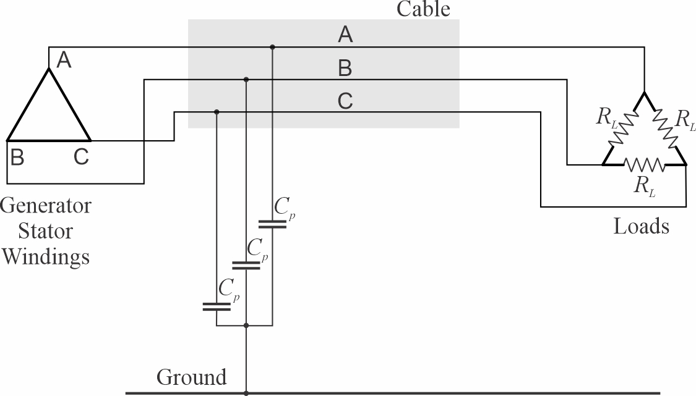
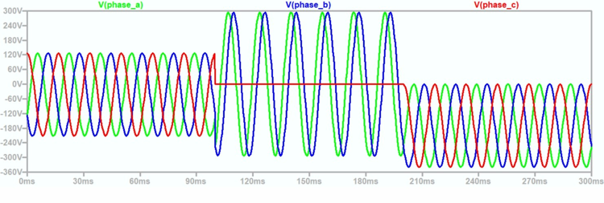
Ungrounded power systems
No intentional connection between power system conductors and ground.
Parasitic capacitances effectively make an ungrounded system capacitively grounded.
  Under normal balanced conditions, no current flows through the hull from the parasitic capacitances.
Continued operation with a single line-to-ground fault possible.
Line-to-ground insulation must be rated for line-to-line nominal voltage.
Susceptible to large transient voltages during intermittent ground faults and other transient events.

Slide 6
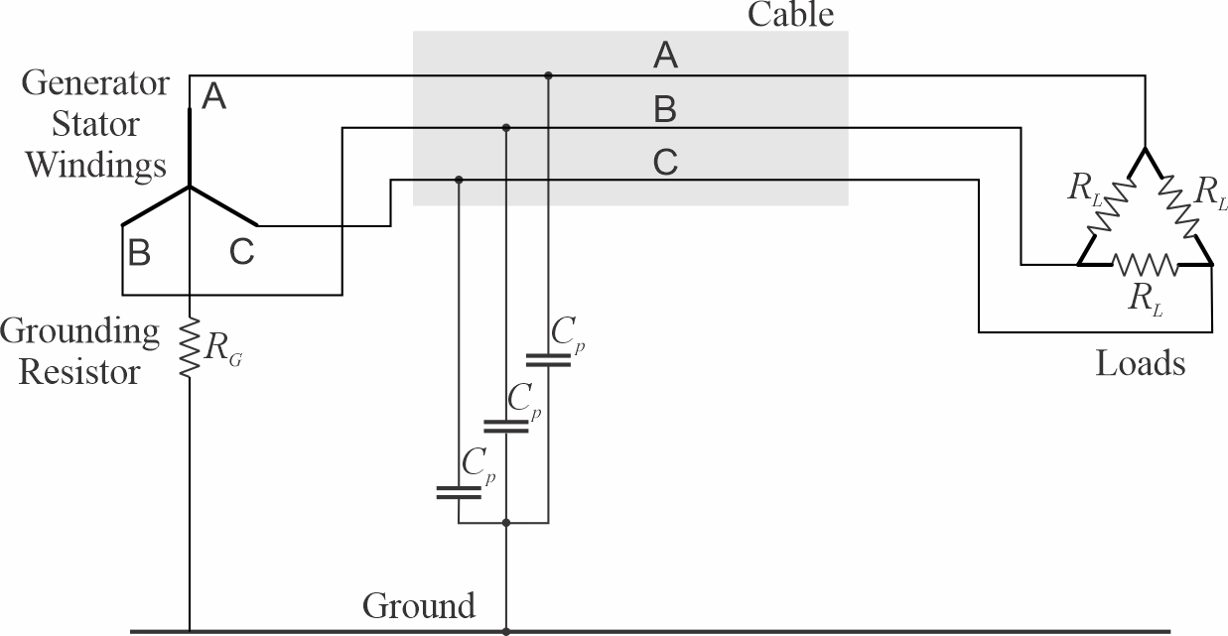
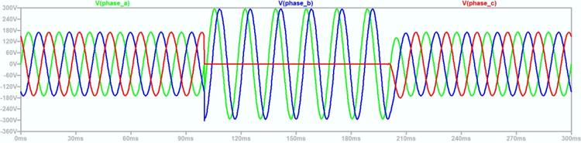
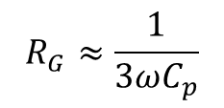
High resistance grounded power system
Neutral of the power system connected by Grounding Resistor to ground.
  Resistor resistance should roughly equal the magnitude of impedance of the parallel combination of the parasitic capacitances.
  Resistor should have power rating greater than the line to neutral voltage squared divided by the resistance.
  A grounding transformer is required if the source is a delta winding.
Under unfaulted conditions, no current flows through the hull of the ship.
Continued operation with a single line-to-ground fault possible.
  Ground fault currents not high enough to trip circuit breakers.
Line-to-ground insulation must be rated for line-to-line nominal voltage.
Much reduced susceptibility to large transient voltages during intermittent ground faults and other transient events.
$$R_{G}≈\frac{1}{3ωC_{p}}$$

Slide 7
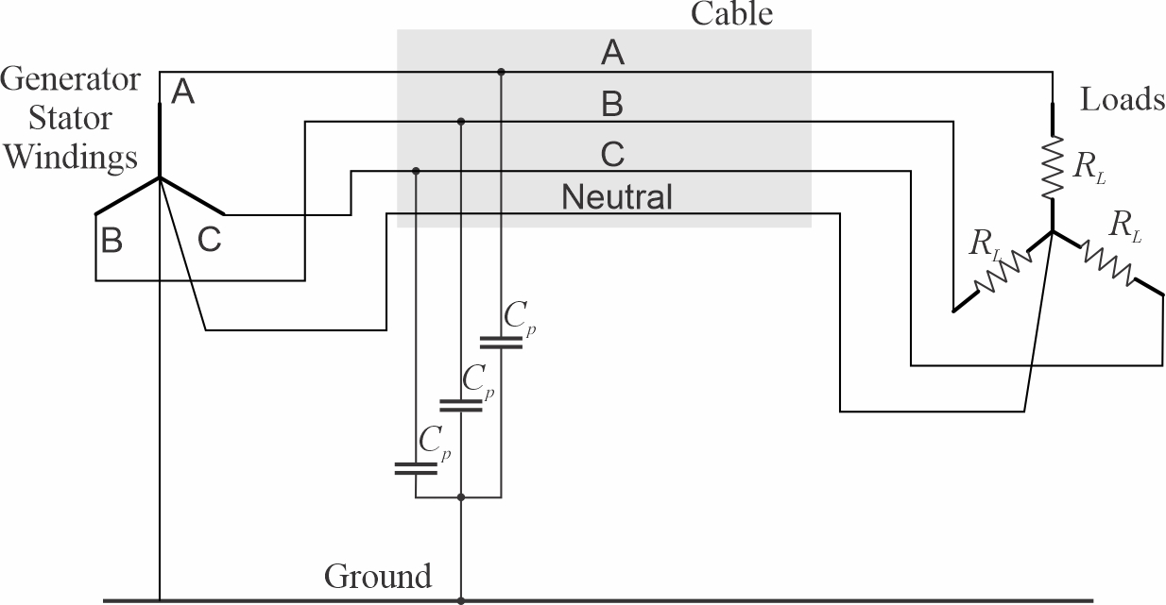
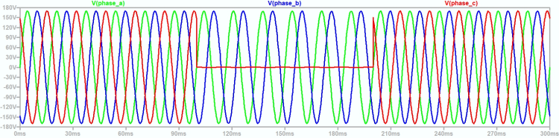
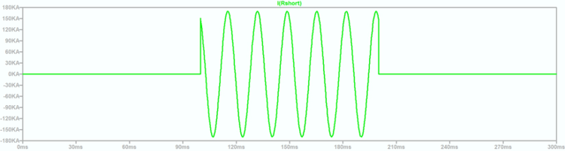
Solidly grounded power system
The neutral connection of the wye connected source is solidly connected to ground.
The neutral connection of wye connected loads may also be solidly connected to the neutral connection of the wye connected source.
  Enables loads with two different voltage ratings (120 / 208 V for example).
During a ground fault, large fault currents flow.
  Circuit breakers trip to isolate the ground fault.
  Loads on faulted circuits automatically lose power; even when it is not desirable.
Generally limited to circuits where the loads are all non-vital.
Line-to-ground Insulation need only be rated for line-to-neutral voltages.
Much reduced susceptibility to large transient voltages during intermittent ground faults and other transient events.

Slide 8
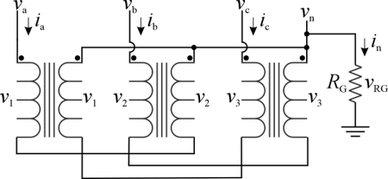
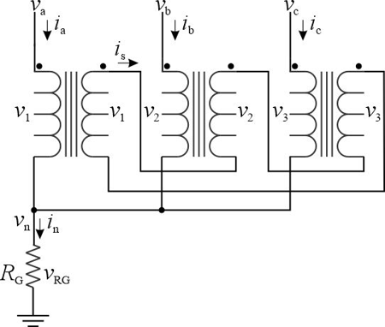
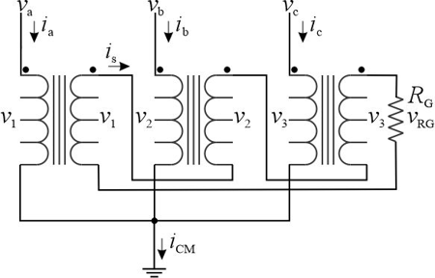
Grounding Transformers
Goal: two terminals with a voltage proportional to the neutral voltage of a three-phase power system
Three common types
  Zigzag transformer
    Low voltage
    Requires turns ratio = 1
  Wye-delta transformer
    Low voltage
    Turns ratio does not have to be 1
  Wye-broken delta transformer
    Medium voltage
    Turns ratio enables using low voltage sensors on grounding resistors

Slide 9
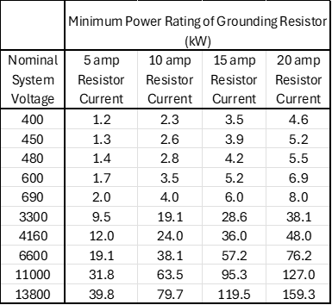
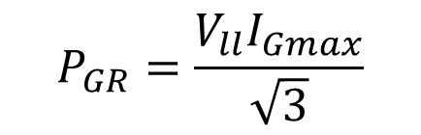
Grounding Resistor
Usually wire wound resistors
Power dissipation during a ground fault can be high
Grounding resistors should have an indefinite rating since the length of time the ground fault will persist is unknown
$$P_{GR}=\frac{V_{ll}I_{Gmax}}{\sqrt{3}}$$

Slide 10
Grounding bus – High resistance grounding
Each separately derived system is required by regulation to have only one point of connection to ground
  Makes sense for solidly grounded systems.
  Not clear why necessary for high resistance grounded systems.
Grounding bus
  facilitates simplifying systems with high resistance grounding,
  while providing only one point of connection to ground.

Slide 11
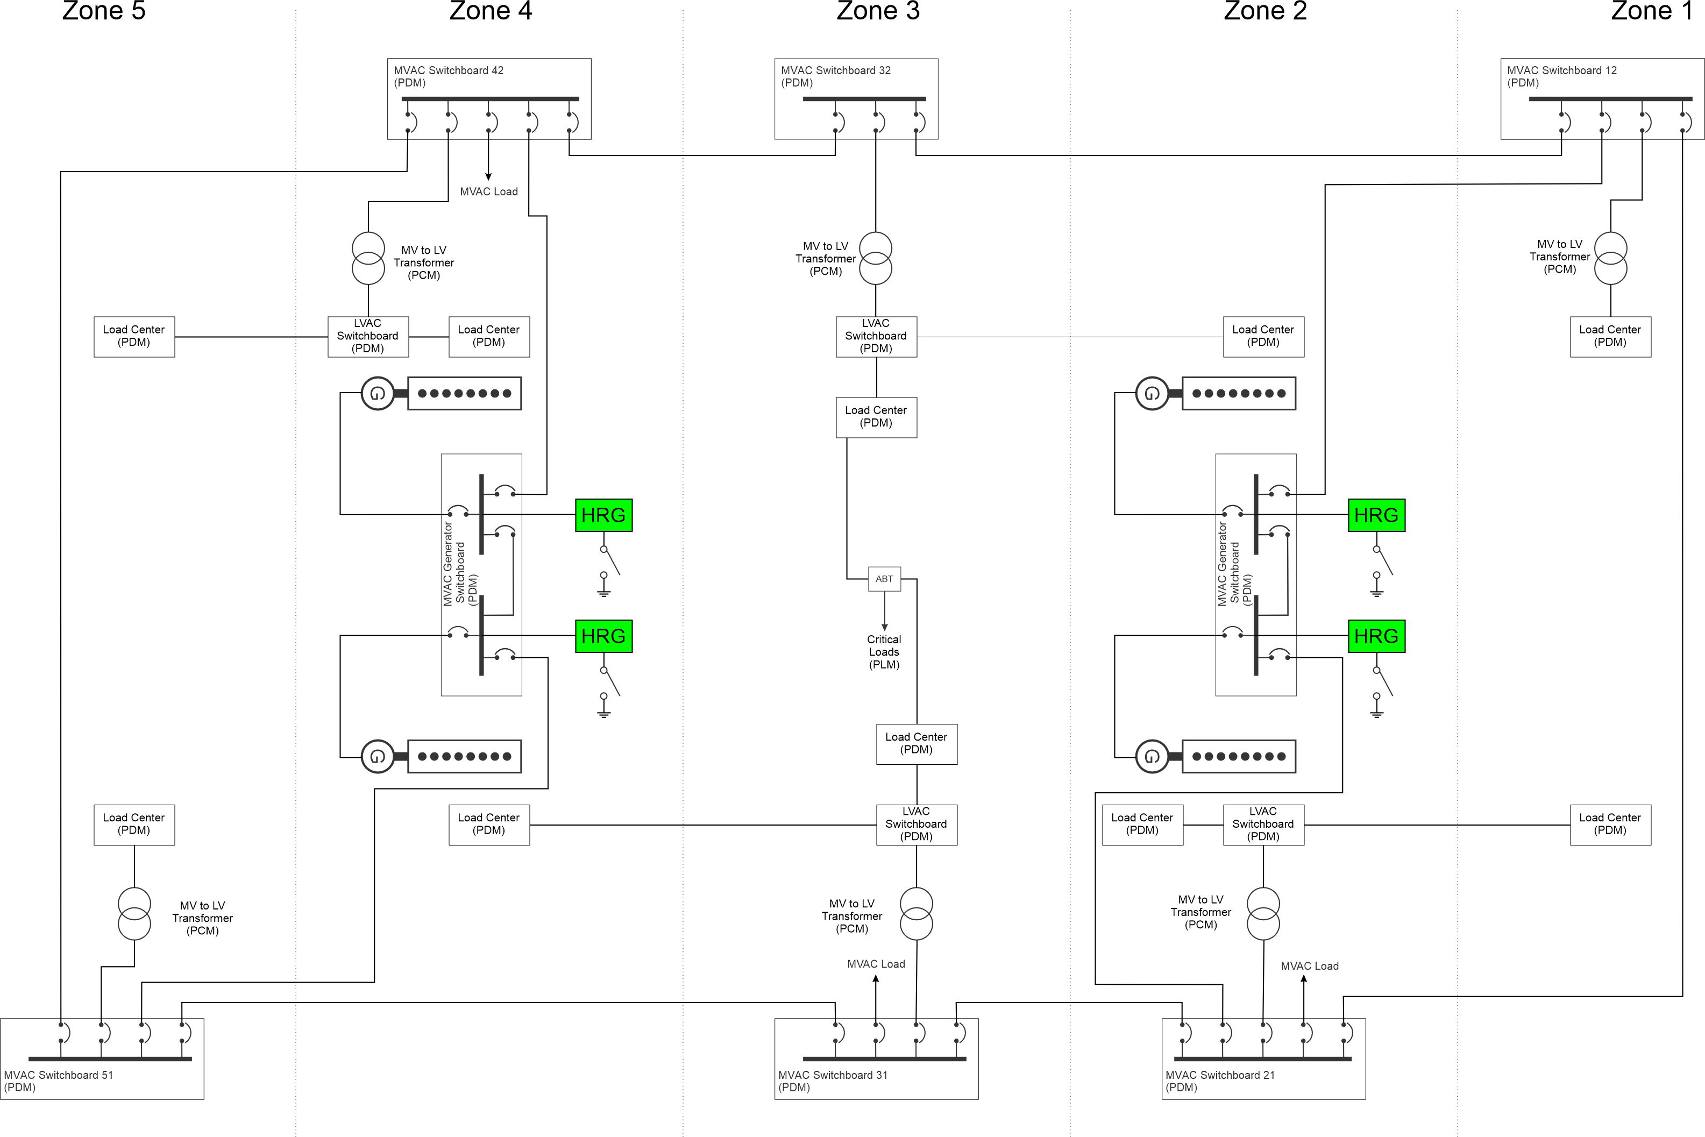
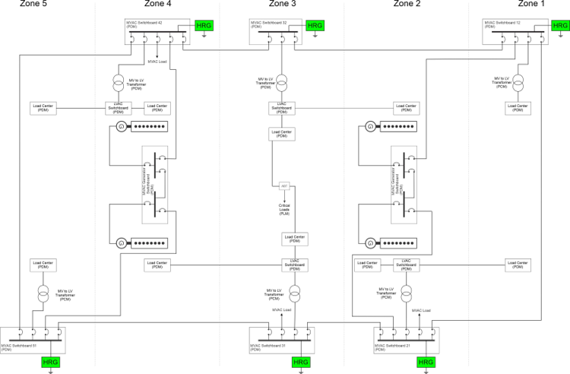
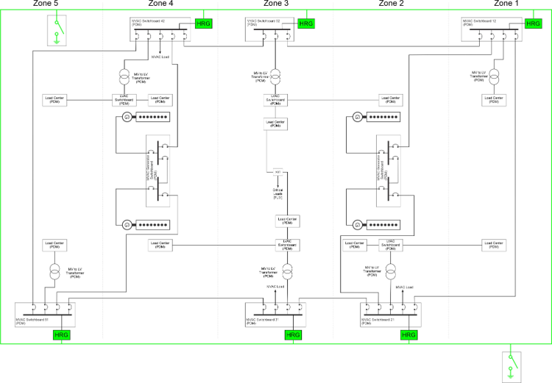
Grounding examples
Grounding resistors individually dissipate much less power as compared to Traditional Approach
Traditional approach
Ground Resistors sized
for total ship C_{p}
Zonal approach
Ground Resistors sized
for zonal served load C_{p}
Grounding bus approach
Ground Resistors sized
for zonal served load C_{p}

Slide 12
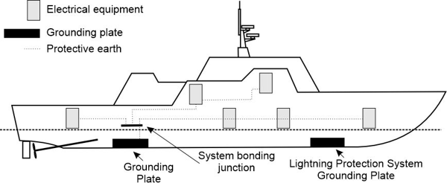
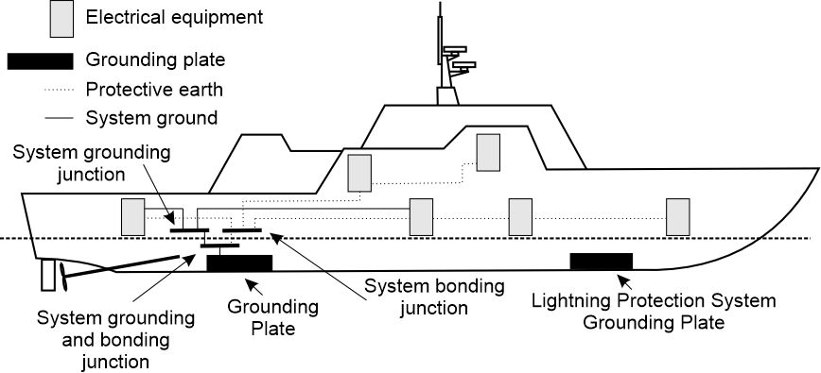
Grounding bus – nonmetallic hull ships
Ungrounded power system
Grounding plate
  Copper
  Minimum 0.2 m²
  Lowest point of hull
Common plate for
  System ground (if needed)
  Protective earthing
Not common with
  Lightning protection system grounding plate
Grounded power system

Slide 13
Applications
Primary bus
  High resistance grounded system
Distribution bus
  Either high resistance grounded system or,
  Ungrounded system
Secondary bus
  Critical loads: high resistance grounded or ungrounded
  Non-critical loads: solidly grounded
Special bus
  May require special grounding treatment

Slide 14
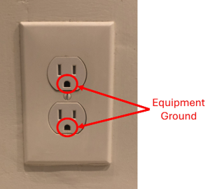
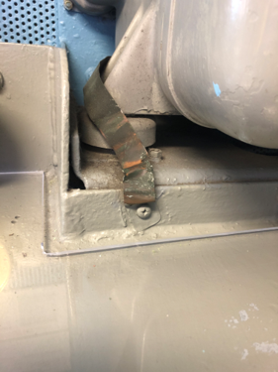
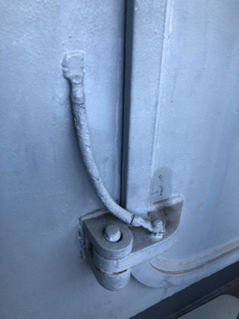
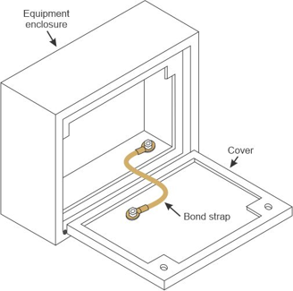
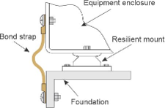
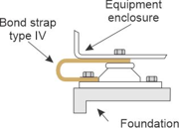
Bonding – Equipment Ground – Protective Earthing
Connect all exposed conductors to ground
  Typically, the ship’s structure
Primarily for personnel protection
Also used to control EMI.
Photos by Norbert Doerry – CC BY 4.Os
Illustrations adapted from MIL-STD-2003-2

Slide 15
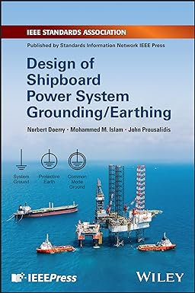
References
IEEE Std 45.1 IEEE Recommended Practice for Electrical Installations on Shipboard--Design
IEEE Std 45.3 IEEE Recommended Practice for Electrical Installations on Shipboard--Systems Engineering
IEEE Std 3003.1 IEEE Recommended Practice for System Grounding of Industrial and Commercial Power Systems
MIL-STD-1310 Department of Defense Standard Practice – Shipboard Bonding, Grounding, and other techniques for electromagnetic compatibility, electromagnetic pulse (EMP) mitigation, and safety
MIL-STD-2003-2 Department of Defense Standard Practice – Electric Plant Installation Standard Methods for Surface Ships and Submarines (Equipment)
Doerry, Norbert, Mohammed M. Islam, John Prousalidis, Design of Shipboard Power System Grounding / Earthing , IEEE Press - Wiley, January 2025, ISBN-10 1119933080 ISBN-13 978-1119933083

